Slide 1
Kazan State Power Engineering University The Presidents of the United States
STUDENT: Safin R.E.
TEACHER: Aitouganova J.I.
Kazan 2019

Slide 2
TARGET AND TASKS
Target:
Tell about the presidents of the United States
Tasks:
The role of the President of the United States
Presidential elections
History
Outstanding Presidents
Interesting Facts
Donald Trump

Slide 3
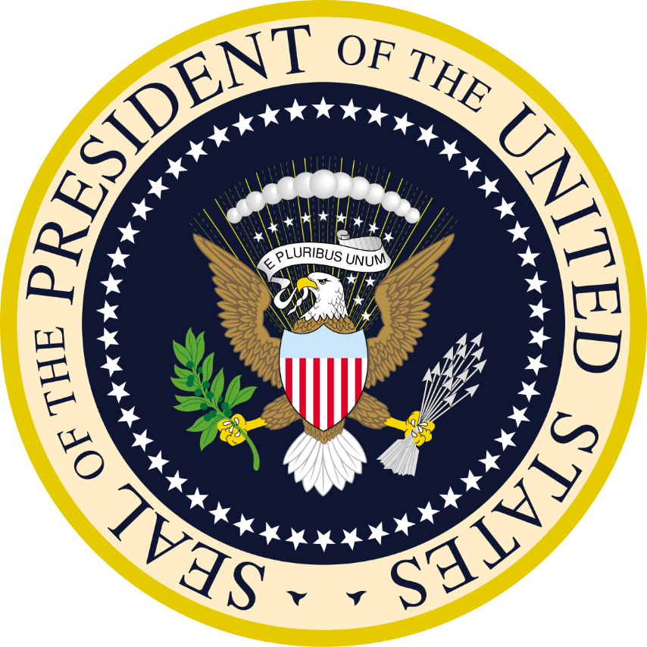
The role of the President of the United States
The President of the United States is the chief executive of the United States with the functions of the head of state and commander-in-chief of the United States Armed Forces. Has the right to veto bills adopted by the US Congress. The position was introduced by the US Constitution, adopted by the Constitutional Assembly in 1787. The White House is the official residence of the US President, where he lives and works. The main function of the US President is to ensure compliance with the country's Constitution and current legislation, as well as the formation of fiscal, domestic and foreign policy.
Seal of the President of the United States

Slide 4
Presidential elections
Under American law, any citizen of the country can become a president of the United States, subject to the following conditions:
age over 35 years;
candidate was born in the USA;
candidate resides in the United States for more than 14 years;
the same person is not elected to the presidency more than 2 times
The peculiarity of the election is that the president is elected in conjunction with the vice-president. The president is elected for a period of 4 years. In the event of the death of the head of state before the next election, the post is automatically held by the vice-president.

Slide 5
History
The first president of the US was in 1789, George Washington. Since 1789, the United States has ruled 44 presidents. In 2017, the 45th head of state, Donald Trump, took office.

Slide 6
Outstanding Presidents
Franklin Roosevelt: The only president of the United States who has been elected for more than two terms. Already in the first hundred days of his presidency, Roosevelt carried out a number of important reforms, restoring the banking system and signing the law on the creation of the Federal Emergency Relief Administration to help the hungry and the unemployed. Headed the country during the global economic crisis and the Second World War
John F. Kennedy: He became the youngest president in US history, as well as the first Catholic president. He played for the equation in the rights of blacks, taking the model of Abraham Lincoln, and for improving relations between the US and the USSR. All funds received from his own salary, donated to charity.
Bill Clinton: During the Clinton presidency, America significantly reduced external debt and unemployment rates, and also became a leader in high technology. It was his administration that has achieved the abolition of nuclear weapons tests worldwide.

Slide 7
Interesting Facts
Andrew Johnson, 17th President of the United States, was the only president who sewed clothing for himself.
President Taft’s weight was almost 160 kg.
Beginning in 1840, every US president who was elected in a year that ends in zero was either killed, died in the workplace, or was seriously injured during the attempt.
The third Monday of February, officially remaining the birthday of George Washington, many celebrate as the birthday of all the presidents of the United States. Employees of public institutions on this day are resting.

Slide 8
Donald Trump
Donald Trump, also known as the current president of the USA, could be described in a few words as a rich, powerful and risky person.
The current head of state was born on June 14, 1946 and grew up in a large family in New York. In 1968, he received a bachelor's degree in economics from the Wharton School of Business at the University of Pennsylvania. Trump founded, reconstructed, and manages various facilities: office buildings, hotels, casinos and golf courses. According to Forbes magazine, he is considered one of the richest people on earth and owns $ 4.5 billion in equity.
Thanks to his public statements and provocative jokes, he is also known as a racist, vulgar and cheerful person. Some people believe that this person is stupid, not serious and can destroy a great country, although every day he makes reasonable decisions and his policies aimed at stabilizing Russian-American relations look very promising from all points of view.

Slide 9
Internet resources
https://ru.wikipedia.org/wiki/%D0%9F%D1%80%D0%B5%D0%B7%D0%B8%D0%B4%D0%B5%D0%BD%D1%82_%D0%A1%D0%A8%D0%90
https://24smi.org/news/64823-spisok-prezidentov-ssha-biografii-gody-pravleniia.html
https://ru.wikipedia.org/wiki/%D0%A2%D1%80%D0%B0%D0%BC%D0%BF,_%D0%94%D0%BE%D0%BD%D0%B0%D0%BB%D1%8C%D0%B4
https://www.nur.kz/1279592-10-samykh-yarkikh-prezidentov-ssha-chem-oni.html

