Slide 1
California
Kazan State Power Engineering University
STUDENTS: Bizikin, Rysin
TEACHER: Aitouganova Jh. Il
Kazan 2019

Slide 2
TARGET AND TASKS
Target: To report about California
Tasks: General information Geography Political system Place of interest Silicon valley Hollywood

Slide 3
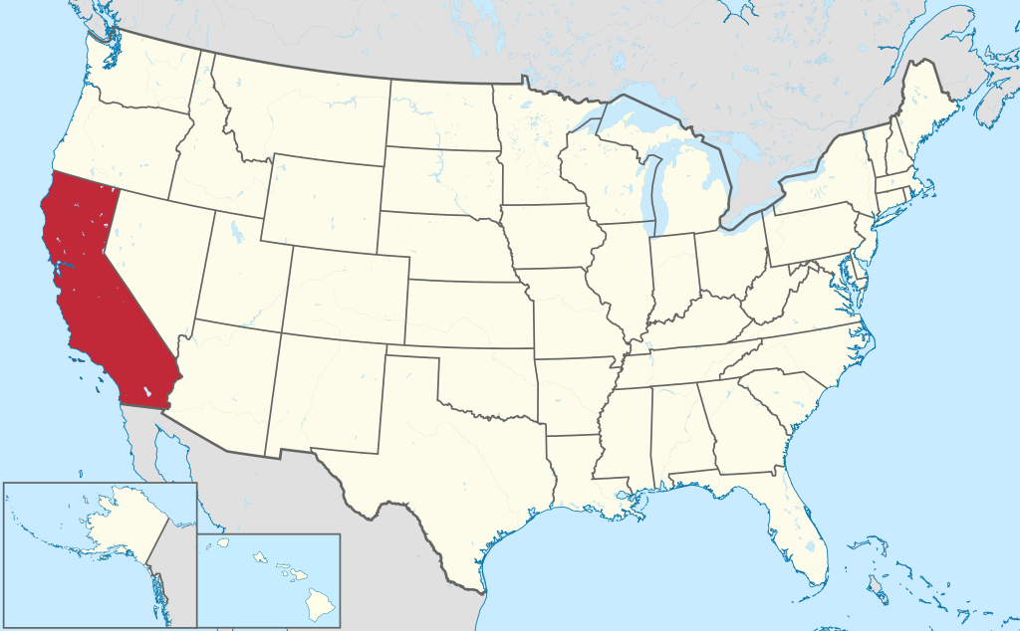
General information
California is the most populous state in the United States and the third largest (after Alaska and Texas). The capital is Sacramento, the largest city is Los Angeles. Other major cities: San Francisco, San Diego, San Jose. The gross regional product of the state of California is $3 trillion — 1st place in the United States. The most important sectors of the state economy — agriculture, aerospace, oil production and processing, show business, information technology.

Slide 4
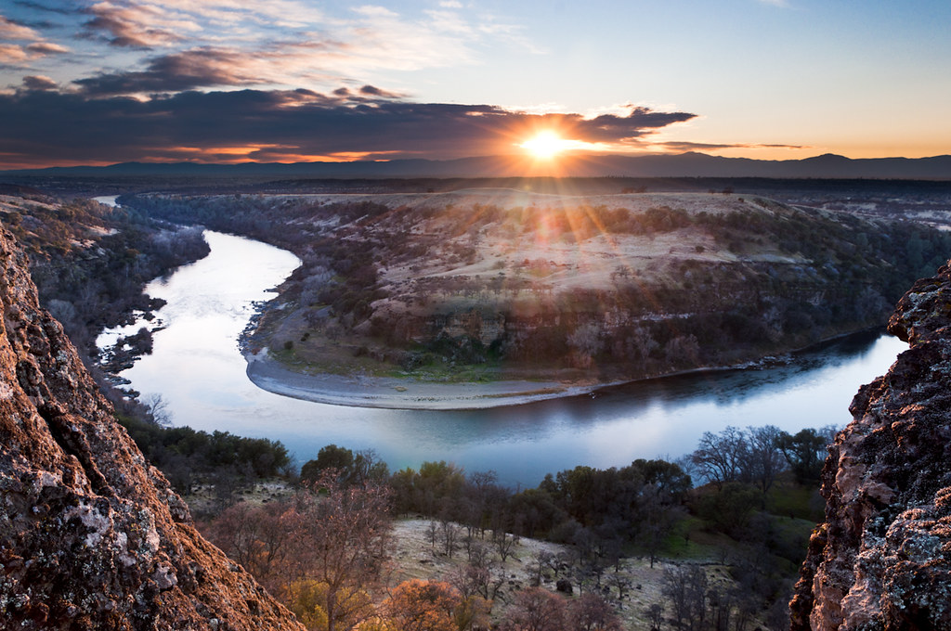
Geography
Geology California is a seismic zone, there are many geological faults in the state, the most famous of which is San Andreas. California also has several volcanoes, including the dormant Lassen Peak, which erupted in 1914 and 1921.
Hydrography California's two largest rivers — Sacramento and San Joaquin. Both of them flow through the Central plain and flow into the Bay of San Francisco. Other major rivers in the state are the Climate in the North and Colorado, part of which forms the natural boundary between California and Arizona.
Climate Most of the state has a Mediterranean climate, with rainy winters and dry summers. The influence of the ocean reduces the temperature spread, leading to cool summers and warm winters. Because of the cold California ocean current along the coast is often fog.

Slide 5
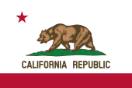
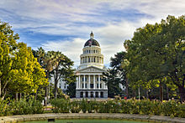
Political system
California is governed as a Republic. It has three branches — Executive, legislative and judicial. The Executive branch is the Governor of the state and other elected officials. The current Governor of California is Gavin Newsome. Legislative power is exercised by the Senate (40 senators) and the Assembly (80 deputies). The main law of California is the Constitution of California — one of the longest legislative documents in the world. Its volume is more than 110 pages. The chief representative of the law in the state is the attorney General. Judicial power is exercised by the Supreme Court of California. The state capital is Sacramento. California has two representatives in the U.S. Senate and 53 in the House of representatives.

Slide 6
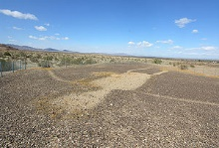
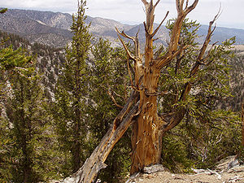
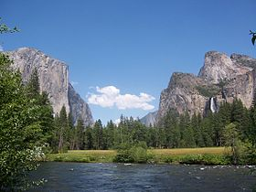
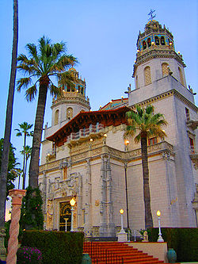
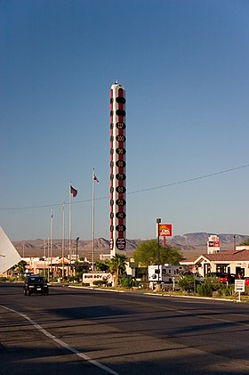
Place of interest
Hollywood
Blythe figures
Methuselah (tree)
Fort Ross Museum-reserve.
Yosemite national park
La Brea Tar Pits
Hearst castle.
Silicon valley
The largest thermometer in the world
As in other States of the United States, California has many railway museums, including museums with full-scale exhibits, operating locomotives and trains. Among such museums: Lomita, Golden Gate.

Slide 7
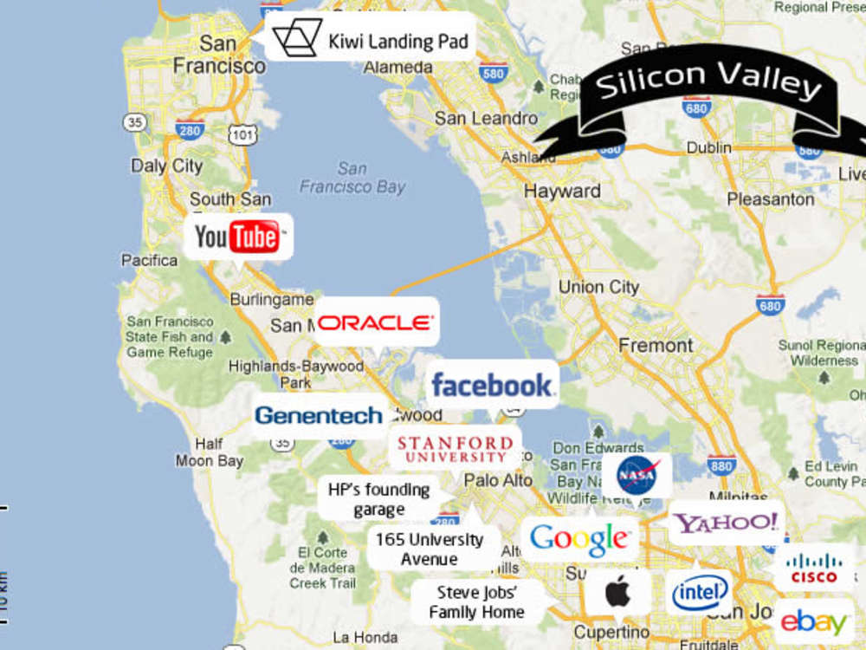
Silicon valley
Silicon valley means a territory - a place where a unique experience of creating and promoting high-tech, high-tech startups has been accumulated, the best platform in the world, where venture investors, developers, startups, representatives of the world's leading technology companies and business media have been successfully cooperating for more than half a century. Currently, about three thousand enterprises have their head offices, representative offices, development or production centers in Silicon valley. The most famous of them are: Apple, Intel, Facebook, Google,AMD, etc.

Slide 9
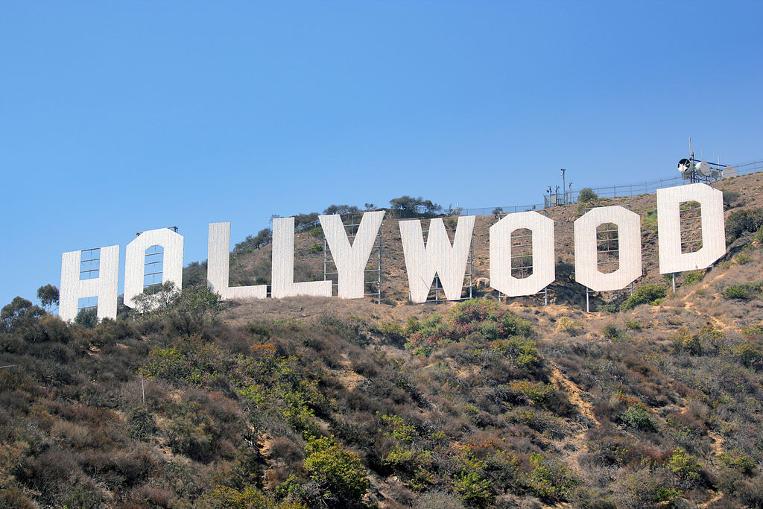
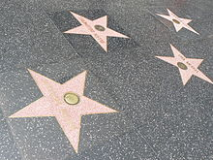
Hollywood
Hollywood is an area of Los Angeles, located North-West of the city center, in the state of California. Traditionally, Hollywood is associated with the American film industry, because in this area there are many film studios and live many famous film actors.
In Hollywood is the world-famous walk of fame — the sidewalk on Hollywood Boulevard and vine street, which invested more than 2,600 five-pointed stars with the names of celebrities who have made a great contribution to the development of the entertainment industry.
Due to its fame and cultural identity as the historical center of film studios and movie stars, the word "Hollywood" is often used as a metonymy for the American film industry.

Slide 10
Internet resources:
https://ru.wikipedia.org/wiki/Калифорния
https://ru.wikipedia.org/wiki/Голливуд
https://ru.wikipedia.org/wiki/Силиконовая_долина

