Slide 1
Washington D.C.
Kazan State Power Engineering University
Student: Utkina Maria
Teacher: Aitouganova Jh.I.
Kazan 2019

Slide 2
Target: tell about Washington
Tasks:
Information about the capital
The White House
The Capitol
The Library of Congress
The National Gallery of Art
Washington Monument
Lincoln memorial

Slide 3
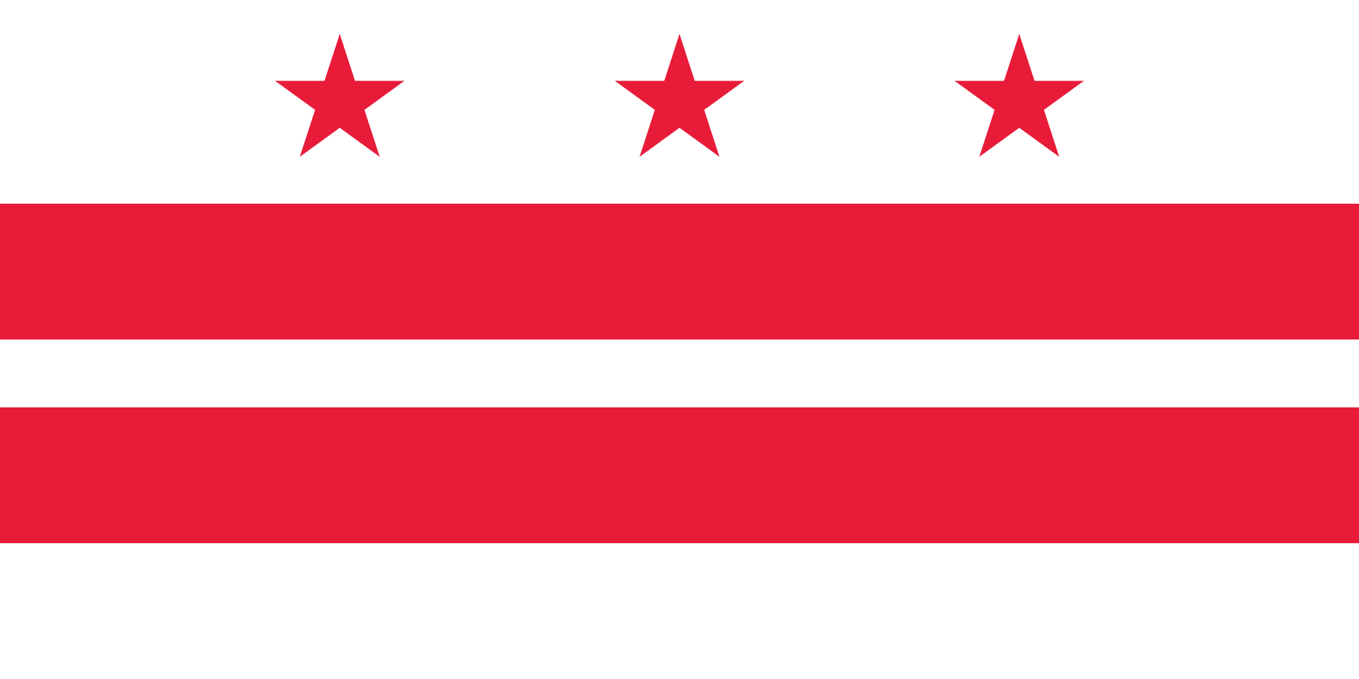
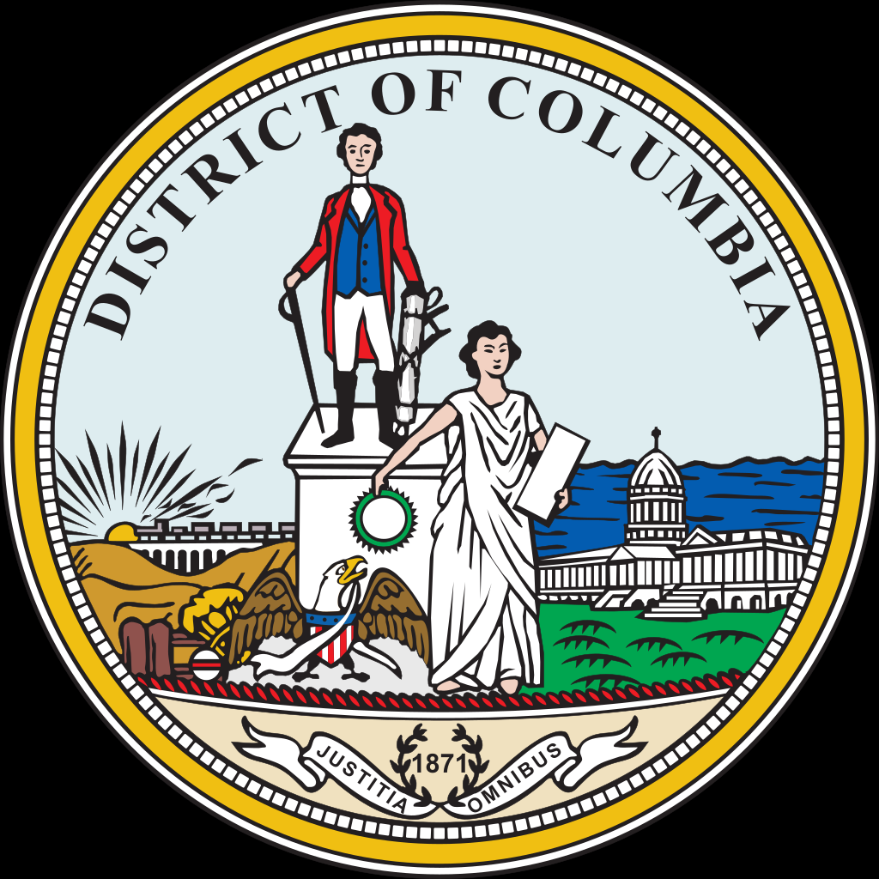
Information
Washington is the capital of the United States of America. The official name is district of Columbia. Its population is over 702000. It’s the world’s largest one-industry city. And that industry is government. The city of Washington was founded in 1791 and named after George Washington, the first American President.

Slide 4
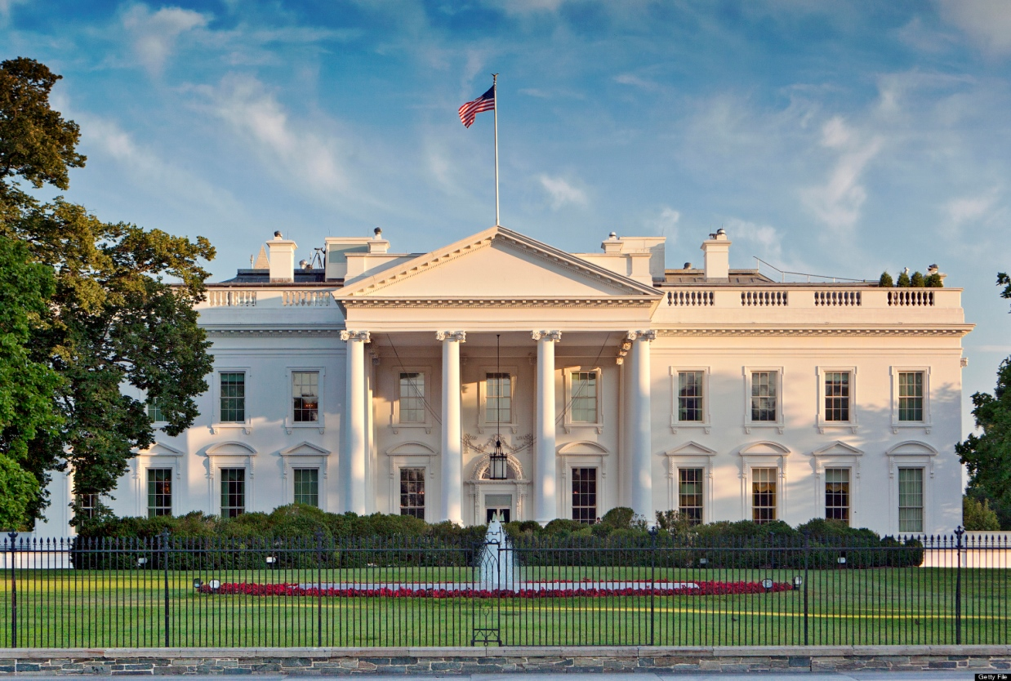
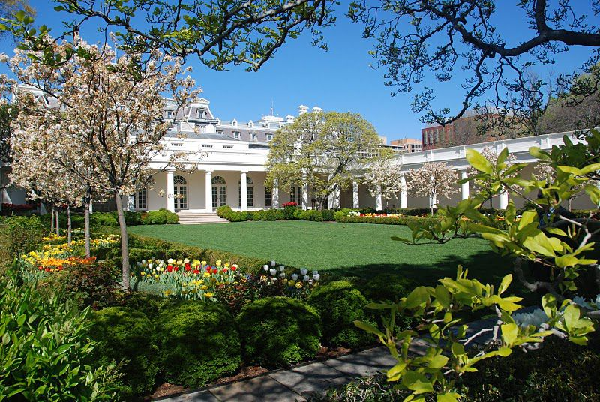
The White House
The White House is the official residence of the President of the United States. It is the oldest public building in Washington. Today, the White House is one of the most popular places for tourists in the United States. There are more than hundred rooms in the White House. The mansion is a six-storey building: its two floors are ground floors; two more are for public receptions and the rest two are for the family of the incumbent President. The White House is surrounded by a beautiful green park.

Slide 5
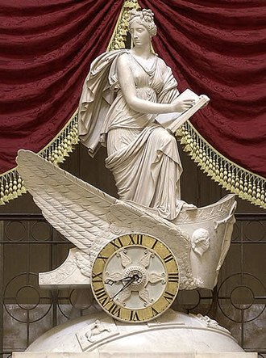
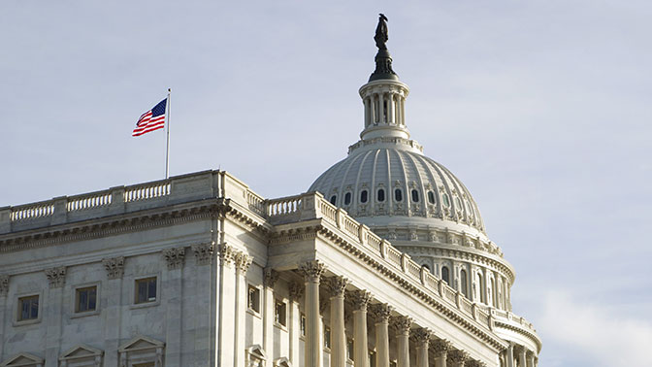
The Capitol
Washington is one of the most beautiful and unusual cities in the United States. In the very center of it rises the huge dome of the Capitol – a big white dome standing on a circle of pillars. The Capitol was founded in 1823. The 535 members of the Congress meet here to discuss the nation’s affairs. It’s easy to get lost in this huge building, full of paintings and statues.

Slide 6
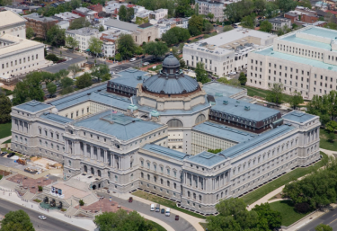
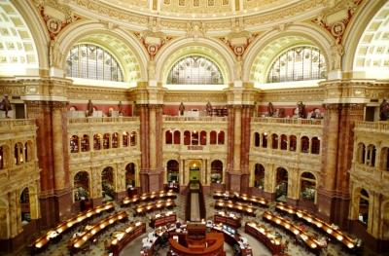
The Library of Congress
Not far from the Capitol is the Library of Congress, the largest library in the States. It was founded on April 24, 1800. It contains more than 13 million books, more than 19 million manuscripts, including the personal papers of the US presidents.

Slide 7
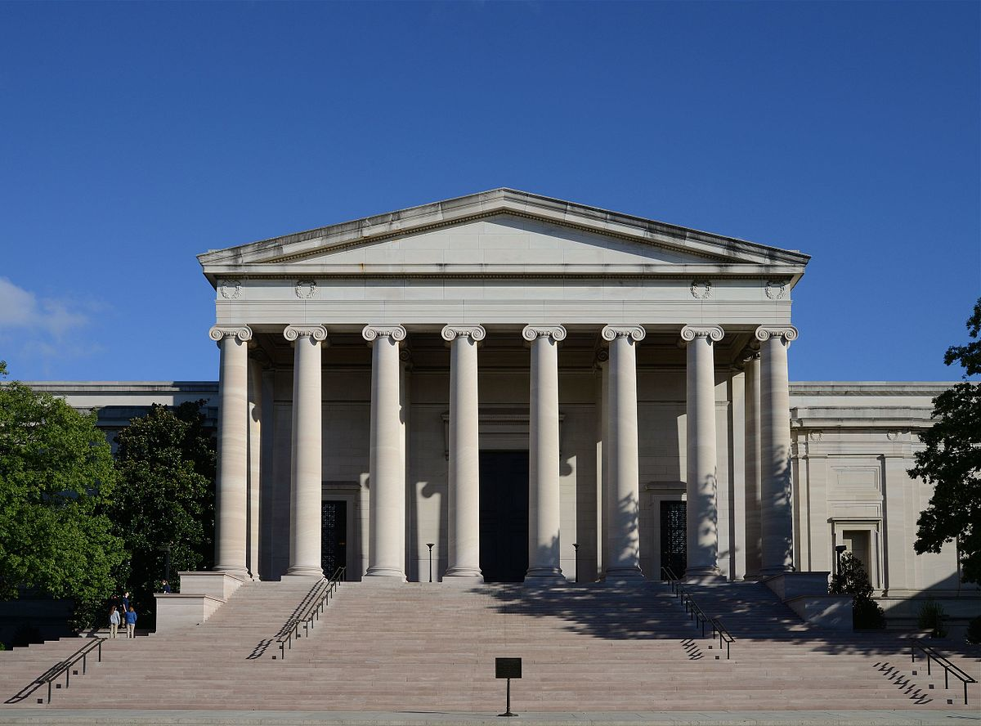
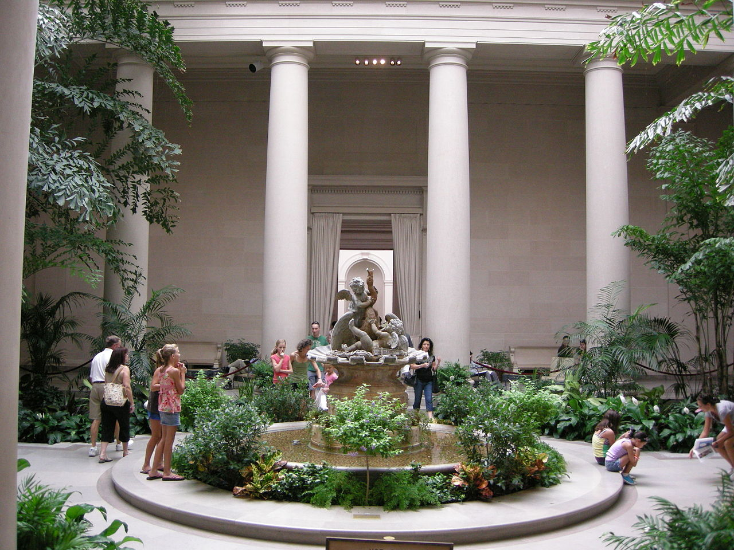
The National Gallery of Art
The National Gallery of Art is one of the largest art museums in the world. It is on the National Mall near the Capitol and features works of American and European art. The National Gallery of Arts contains art collections by the great masters of the 14th to 18th centuries. The Sculpture Garden contains plantings of Native American species of canopy and flowering trees, shrubs, ground covers, and perennials. Addition to the complex is the National Gallery of Art Sculpture Garden. Completed and opened to the public on May 23, 1999, the location provides an outdoor setting for exhibiting a number of pieces from the Museum's contemporary sculpture collection.

Slide 8
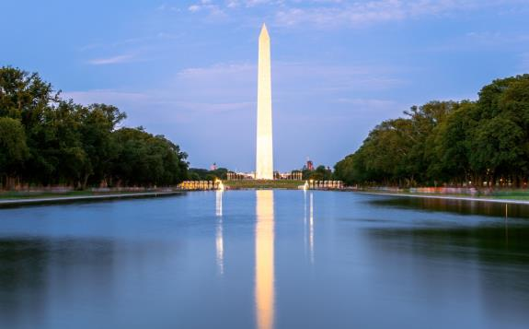
Washington Monument
Washington monument-lined with Maryland marble granite obelisk height of 169 meters and a mass of 91 thousand tons, was erected in 1848-1884 in Washington, between the White house and Capitol, designed by Robert mills as a monument to the first President of the United States, George Washington.

Slide 9
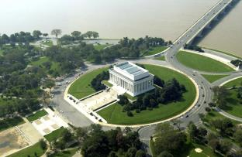
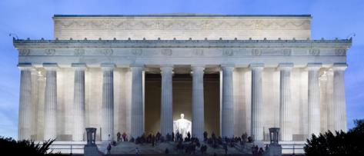
Lincoln memorial
Lincoln memorial is a memorial located on the national Mall in Central Washington. It was built in honor of the sixteenth US President Abraham Lincoln. His presidency was during the Civil war (1861-1865). The memorial, erected in 1914-1922, symbolizes Lincoln's belief that all people should be free. Compositionally, the building symbolizes the Union.

Slide 10
Sources:
https://ru.wikipedia.org/wiki/
https://www.google.ru/imghp?hl=ru&tab=wi
Aitouganova Jh.I.’s collection of oral topics

